Slide 1




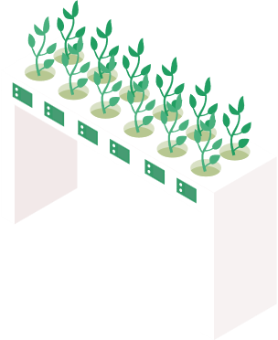

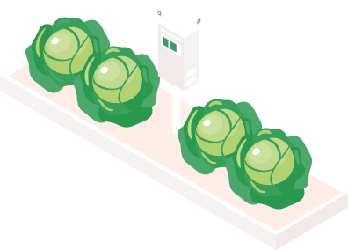
SMARTAGRI
DolphinGroup
Project presentation

Slide 2

task 1
task 2
task 3
task 4
task 5
Executive summary
Problem
The use of technology in agriculture is on the rise.
Ineffective and synchronous yields
Weak interconnection of agribusiness
Target audience
Gender: All gender
Age: Gen X – Gen Z
Hobbies: Agriculture, Investment.
Solution
A hybrid-app can:
+ Connects parties in Agribusiness
+ Update high-tech agricultural news
+ Find investors
Highlights
Investment feature
E-com service
Sharing knowledge forum
Gains & lessons
Experience to work in a short project

Slide 3
Agenda
Project Implementation
Project Timeframe
Final product
Self-assessment
Problem, solution & goal
Brainstorming report
Task management Accomplishment
Features
Technical stack
Potential
Quality of works
Level of success of the project
Takeaway experience

Slide 4





Personnel
Dang Loc Project Manager
Phuoc Tung Product Manager
Vi Khang Technical Architecturer
Thu Trang ​BA, Financial Manager
Thanh Hai Tester

Slide 5
Problem
Project implementation
Lack of high
technology applications
Weak connection between customers, farmers and companies
Product yields are not effective and synchronous

Slide 6
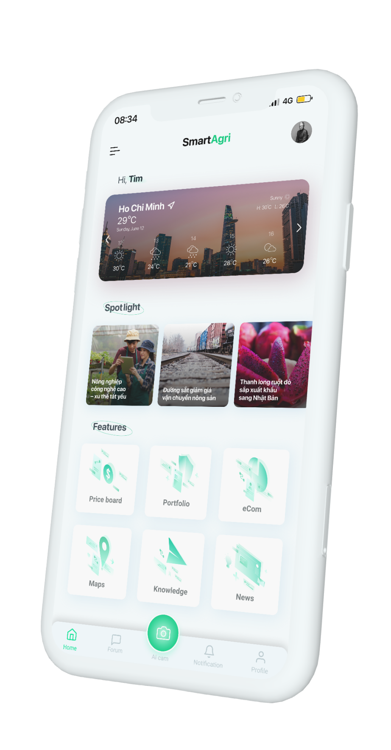



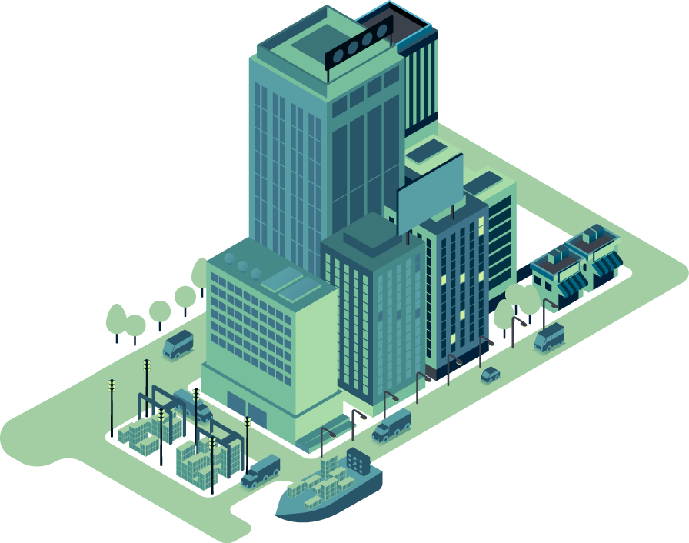

Idea
Project implementation
Connects parties
in Agribusiness
Update high-tech agricultural news
Find investors

Slide 7
Goals
Project scope
1 Optimize productivity and yields.
2 Low prices smart app
3 Synchronizing products.
4 Real-time interaction, high accuracy

Slide 8

Research report
Brainstorming stage
Market need
Agriculture is becoming more technologically advanced
Creating and growing agricultural industries in using high-tech
SWOT analysis
Strengths | Weakness
Agricultural is the key economic sector of Viet Nam. Many tools for data collection, analysis, and statistics. | The need for supply chain partners. High-tech farm can be prey expensive.
Oppounities | Threats
The government promotes technology in agriculture. People tend to buy clean, safe products from food chains. | A diverse range of plants, it is challenging to cover. Agriculture’s aging population. Data-theft with consumers and suppliers.
Make a basic platform, attract users at the initial stage.

Slide 9




Planning
Brainstorming stage
Target Customer
Gender: All gender
Age: Gen X – Gen Z
Hobbies: Agriculture, Investment.
The farmers
The youngsters
The merchants
Profit model
Cost of IPO
Investment
Cost per exchange
Commission from customer
E-Com
Listed on the market pre-money
Competitors
Delivery
Forum

Slide 10








Finance
Manage working process
Free
Storing data, files, information
Free
Communication
Free
Conduct meeting
Free
UI/UX design
Free
Reference resources, data researching
Free

Slide 11
Project timeline
Milestone | Description | Assignee | Begin Date | Target End Date | Completed Date
Phase 1: Kick-start | Research, strategize & plan; Develop ideas | All members | 05/11/2021 | 05/12/2021 | 05/12/2021
 | Assumption of risk | Tùng, Khang, Trang | 05/11/2021 | 05/12/2021 | 05/12/2021
 | Project introduction | All members | 05/11/2021 | 05/12/2021 | 05/12/2021
 | Project proposal | All members | 05/13/2021 | 05/19/2021 | 05/19/2021

Slide 12
Project timeline
Milestone | Description | Assignee | Begin Date | Target End Date | Completed Date
Phase 2: Run-up | Industry, Market & Business research | All member | 05/25/2021 | 06/06/2021 | 06/12/2021
 | App feature description | Tùng | 06/13/2021 | 06/23/2021 | 06/20/2021
 | Contents | Khang, Trang, Hải | 06/22/2021 | 06/27/2021 | 06/26/2021
 | Target audience | Trang, Hải | 06/22/2021 | 06/25/2021 | 06/25/2021
 | Technical design | Khang | 06/27/2021 | 07/17/2021 | 07/13/2021
 | Visualization UI/UX design & app prototype | Lộc, Tùng | 06/27/2021 | 07/18/2021 | 07/19/2021

Slide 13
Project timeline
Milestone | Description | Assignee | Begin Date | Target End Date | Completed Date
Phase 3: Closure | Completing paperwork, documentations | Lộc, Tùng, Khang | 07/10/2021 | 07/20/2021 | 07/20/2021
 | Self-assessment of project | Lộc, Trang | 07/11/2021 | 07/18/2021 | 07/17/2021
 | Takeaway experiences | All members | 07/18/2021 | 07/21/2021 | 07/20/2021

Slide 14

Accomplishments
Successfully developed agricultural e-com with synchronized quality, price, and product source.
Created a platform that connects components in the Agribusiness ecosystem to motivate delivering farm produce, and optimize supply chain.
Expanded the agricultural knowledge-sharing community, follow high-tech agricultural tendencies.

Slide 15
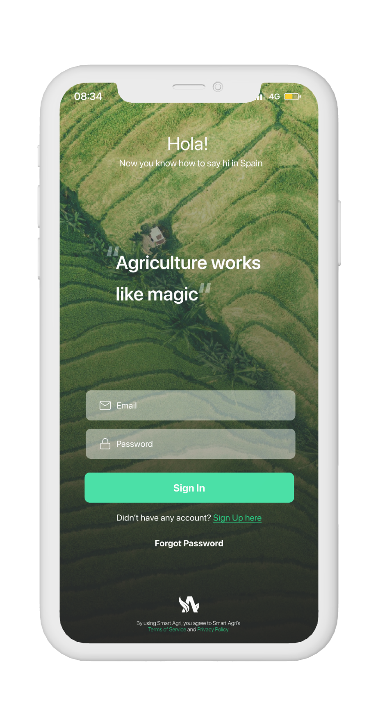
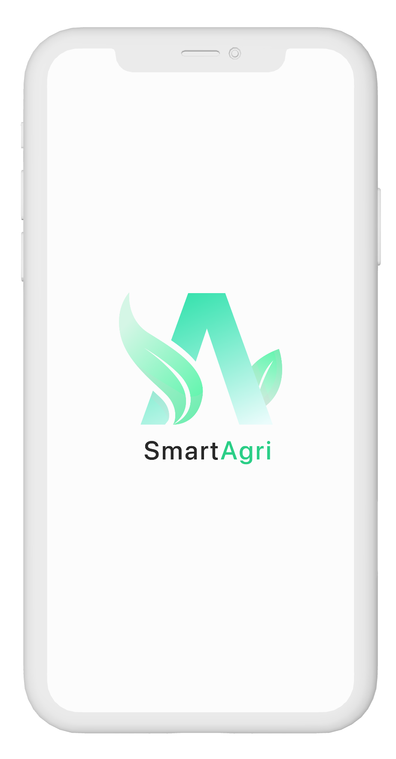
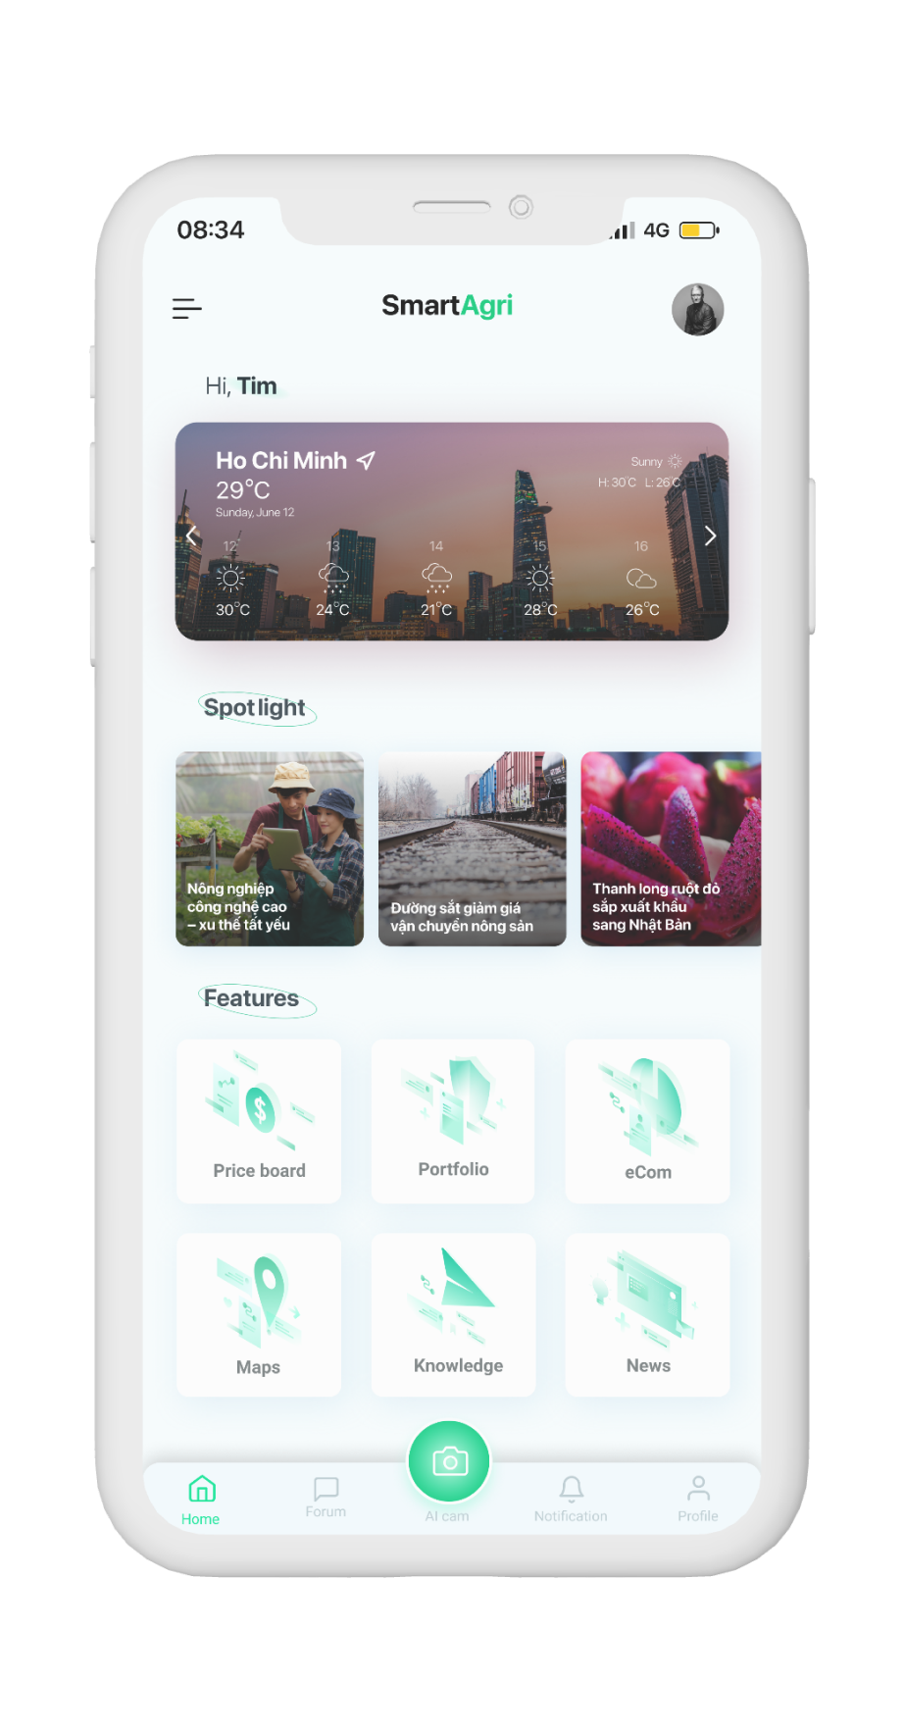
Introduction
Final product
SmartAgri
Offers these services:
Online Grocery delivery
Farm investment service
News
Farms map
Knowledge

Slide 16
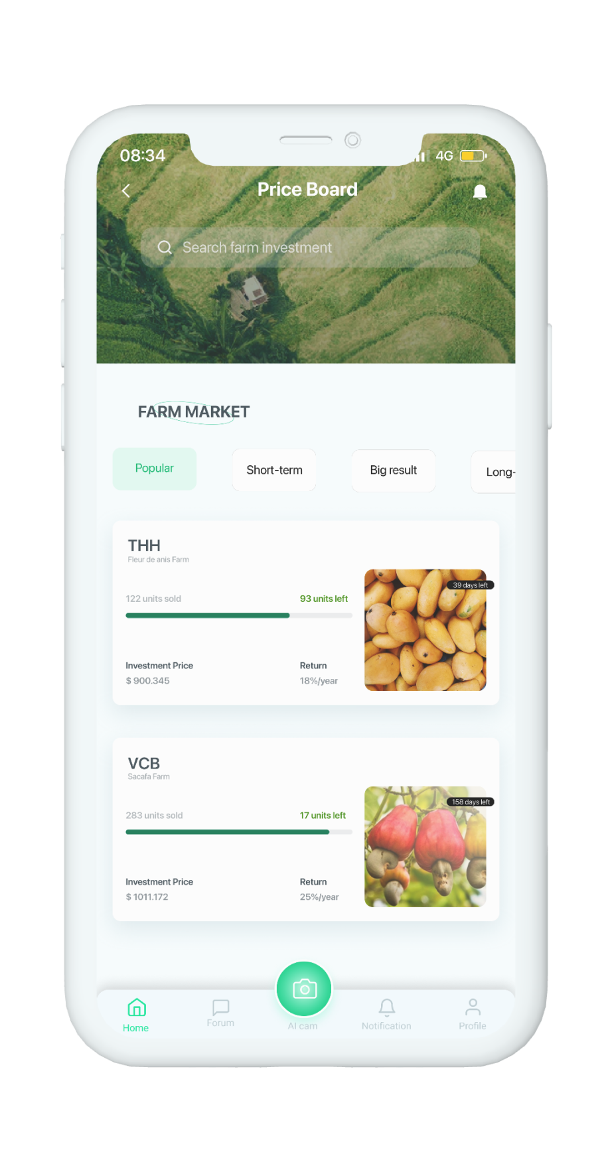
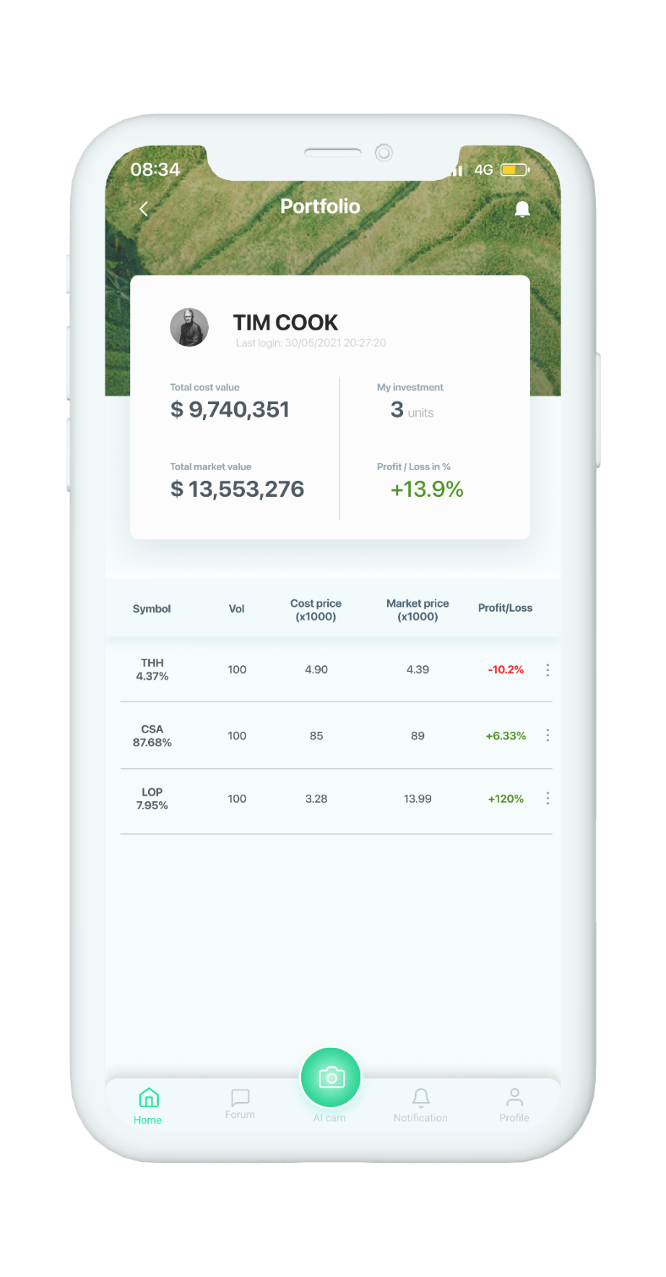
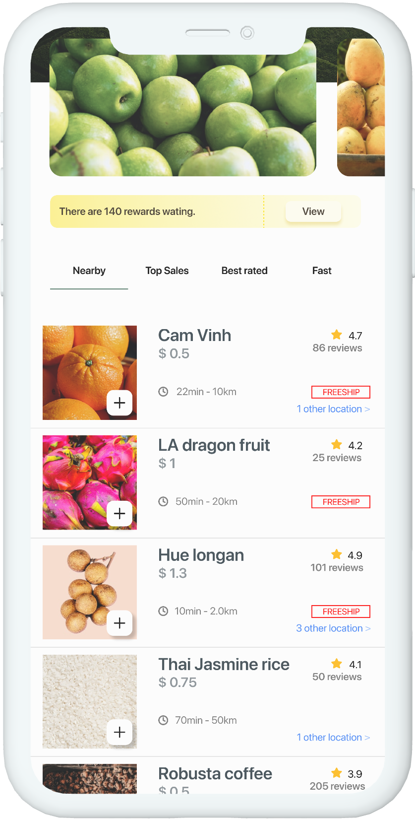
Features
SmartAgri
Final product
Priceboard
Portfolio
eCom

Slide 17
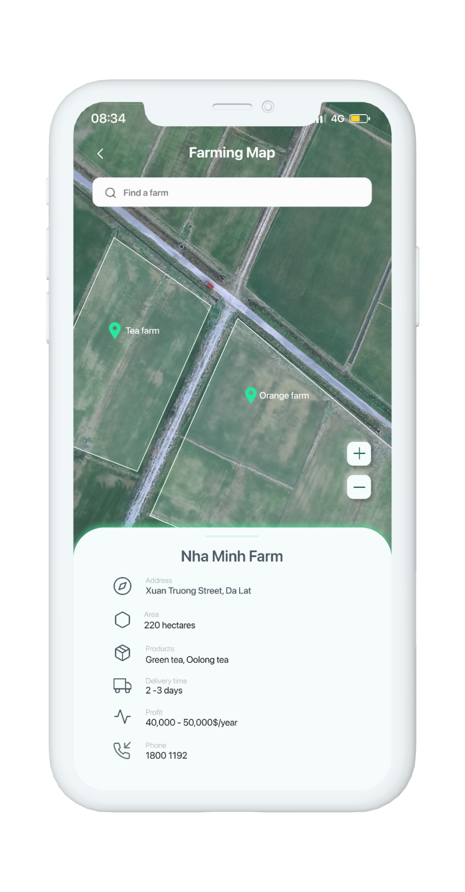
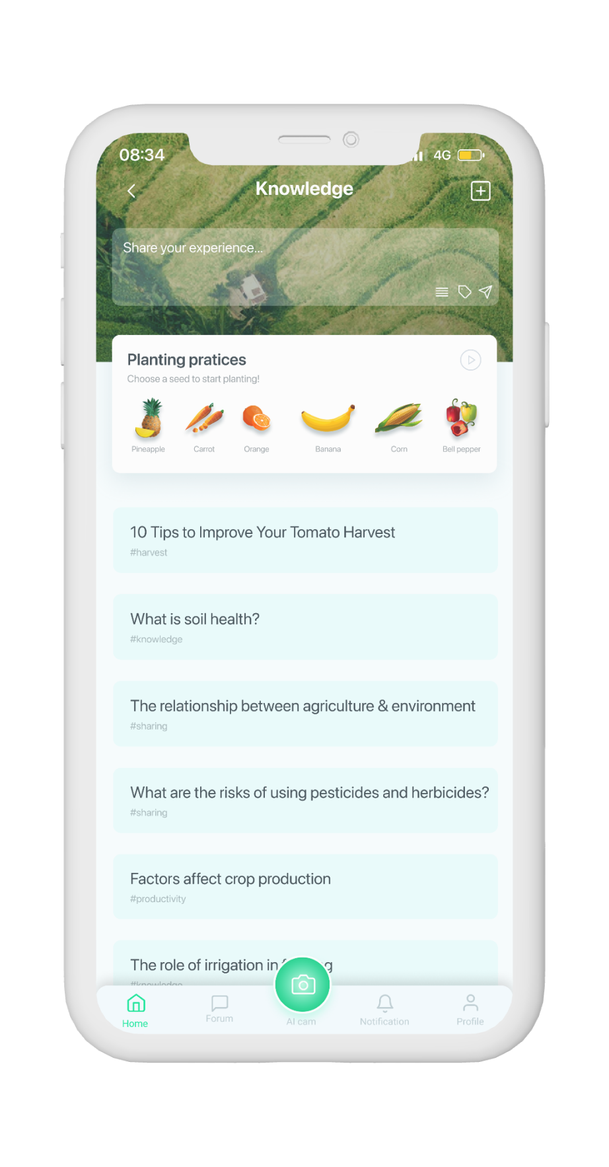
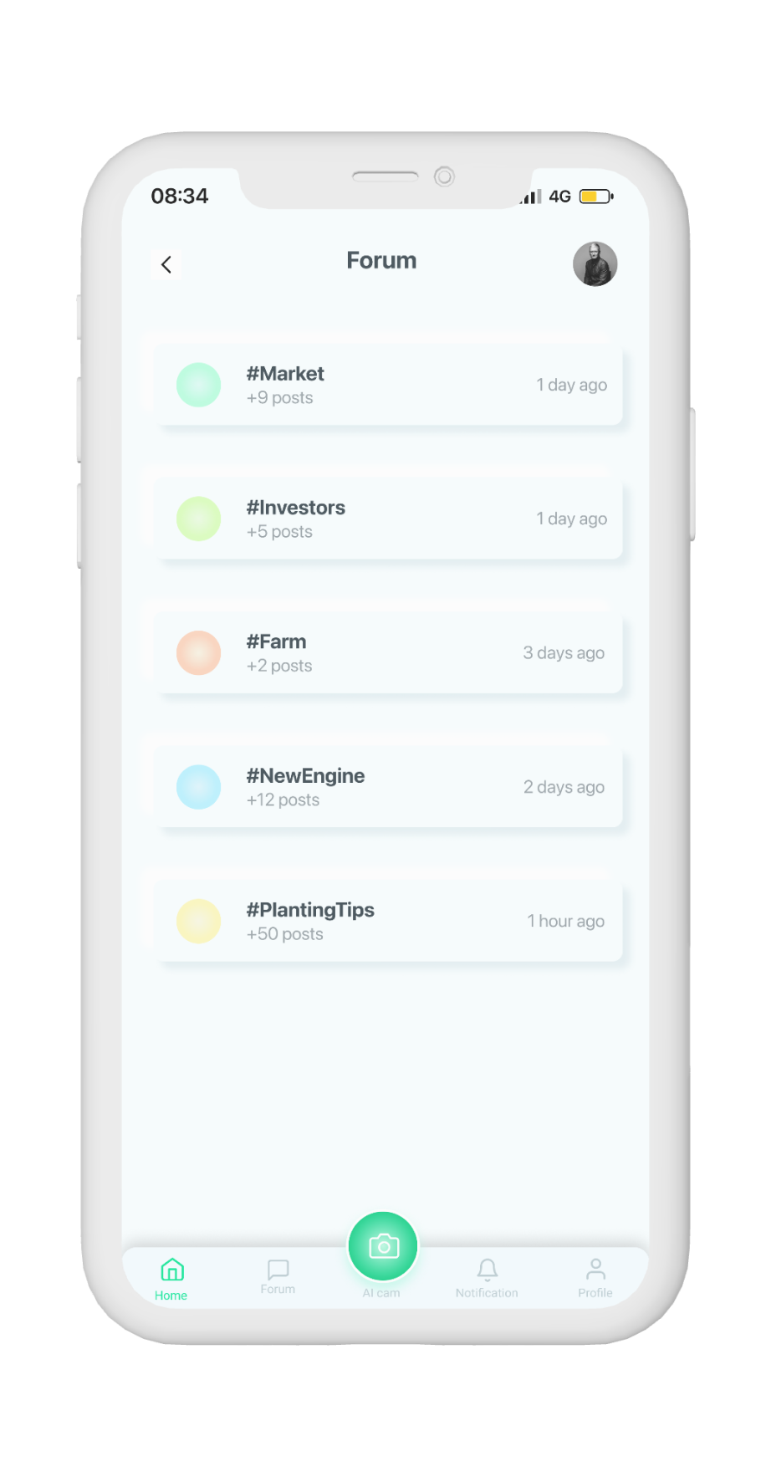
Features
SmartAgri
Final product
Farm Map
Knowledge
Sharing forum

Slide 18







Technical stack
Final product
Operating system
Servers
Databases; Authentication; Hosting
Front-end frameworks (user interface)
Data analytic platform
AI services
Versions control

Slide 19

Risk
Misunderstand use of features
Smart Agri lacks actual data.
Challenging UX design for different types of users

Slide 20
Potential
IoT applications
Sensors, drones or weather indicators, .etc
AI intergrated
Recognizing plants through pictures
Real-time contact
Tracking the growing state of the plants
Bigdata applications
Analyzing database suggestions between investors and farm owners

Slide 21
Self-assessment
Project
Manpower
Product
Task management
95%
Communication
70%
We achieved our main goals proposed before
Task complete on time
Not really effective
Adjustments in working
Analysis
The limitations of project was unclear at first, after some meeting and conversation, we found the same voice.
Work sharing
80%
Leadership
Shared equally
Good, work effectively
Design
Members help the others complete tasks
Detailed and creative
Problem solving
70%
Implementation
Everyone is supportive and ready to help the others
Following the design but flexible
Successfully implemented basic features
Basic and modern UI
Pay attention to UX

Slide 22
Gains & lessons
Self-assessment
Summarize the group's tasks and processes, clarify the team's strengths and weaknesses
Learn more about Vietnam's agricultural market and the applications of technology in agriculture
Know how to work on a large process broken down into small & specic phases
Learn how to use technology platforms, applications to create products
Have a broader view of many other aspects when making a product
(market demand, customer psychology, implementation costs, ...)

Slide 23
THANK YOU!
If you have any questions?
Don’t hesitate to ask us
or contact us
dolphin.team111@gmail.com
DolphinGroup

